Slide 1

STAT 5003 – COMPUTATIONAL STATISTICS
GROUP 10
Members: Hui Tong, Julia Lee, Shaun Kee, Hatish Satiah, Tai Hang Fu

Slide 2
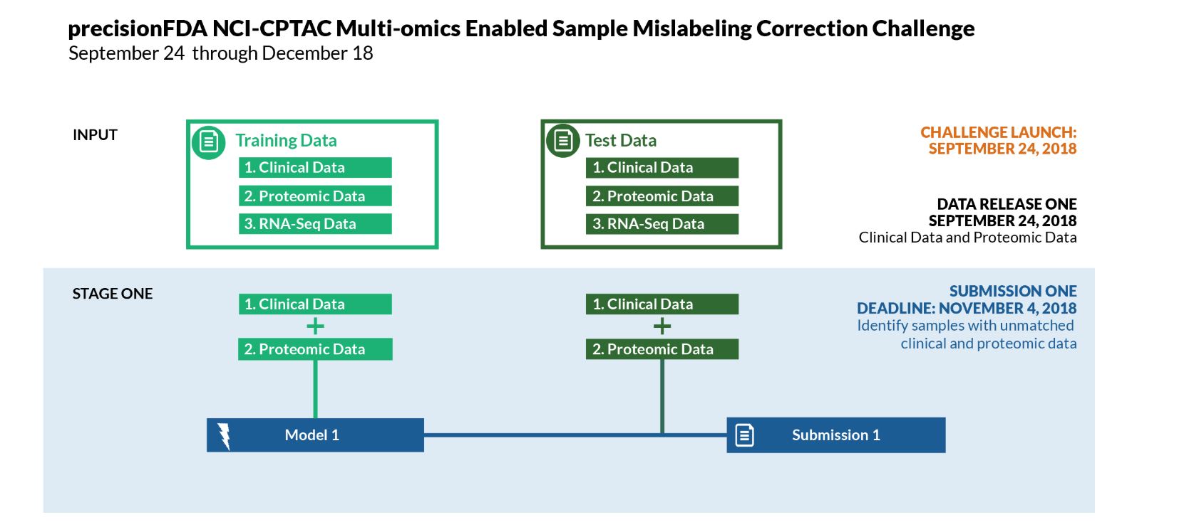
FDA DATASET
Combine clinical data into 4 classes
Impute N/A Values
Dimension Reduction
Classification Models
Compare Results
Remove mislabels in Training Set
APPROACH
Notes:
We selected the FDA dataset with the task of predicting mislabeled samples. Our approach was as follows:
Firstly we combined the clinical data to get 4 classes. Then we imputed the N/A values. After that we tried dimension reduction and then removed the mislabeled samples from the training set. Finally we applied different classification methods and compared the results.

Slide 3
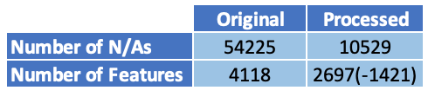
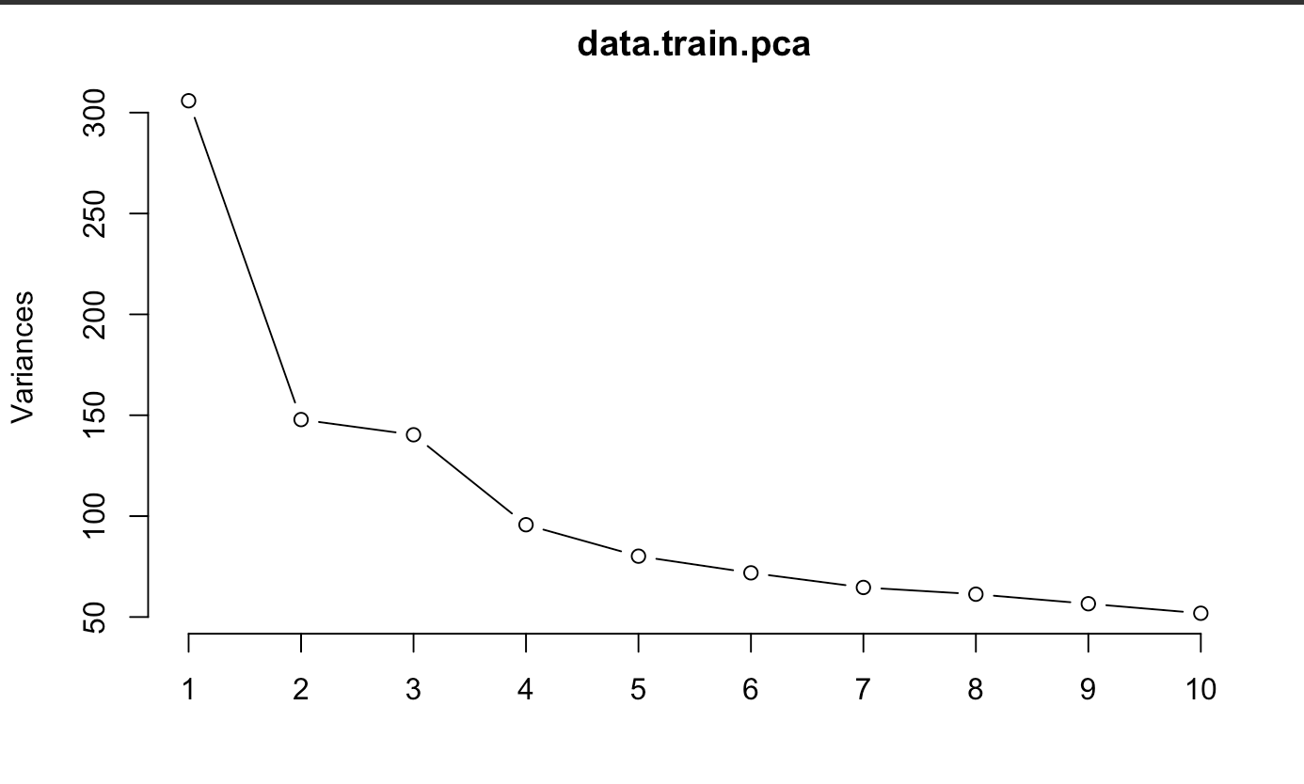
4. Remove mislabels in Training Set
APPROACH
1. Combine clinical data into 4 classes
2. Impute N/A Values
Removed manyNAs
KNN Imputation
3. Dimension Reduction / Feature Selection
Principal Component Analysis (PCA)
Feature Selection
Wrapper Method – Forward Stepwise
Notes:
To go in more details, getting the 4 classes was easy. It only involved combining the gender and msi columns. To perform imputation we firstly removed all the samples with manyNAs. The table shows a summary of the number of NA values and samples that were deleted. We then applied KNN Imputation to the 2697 remaining samples. Since the data was of high dimension, we performed PCA and Feature selection but all of them had a negative impact on the accuracy so we decided not to use them. We then removed the mislabels in the Training set and only performed classification on the correct labeled samples.

Slide 4
APPROACH
5. Classification
Bagging – Decision Tree
KNN
Logistic Regression
Random Forest
AdaBoost
Train 5 model using training dataset
Predict class labels using test dataset
Compare predicted labels of 5 models and vote for label with highest probability score
Notes:
In terms of classification, we trained 5 different models: Bagging with Decision tree, KNN, Logistic Regression, Random Forest and AdaBoost. We then predicted the labels using the test set. In order to determine the probability of a sample being mislabeled, we compared the predictions from the 5 different models and voted for the highest probability. Shaun will now discuss the results.

Slide 5
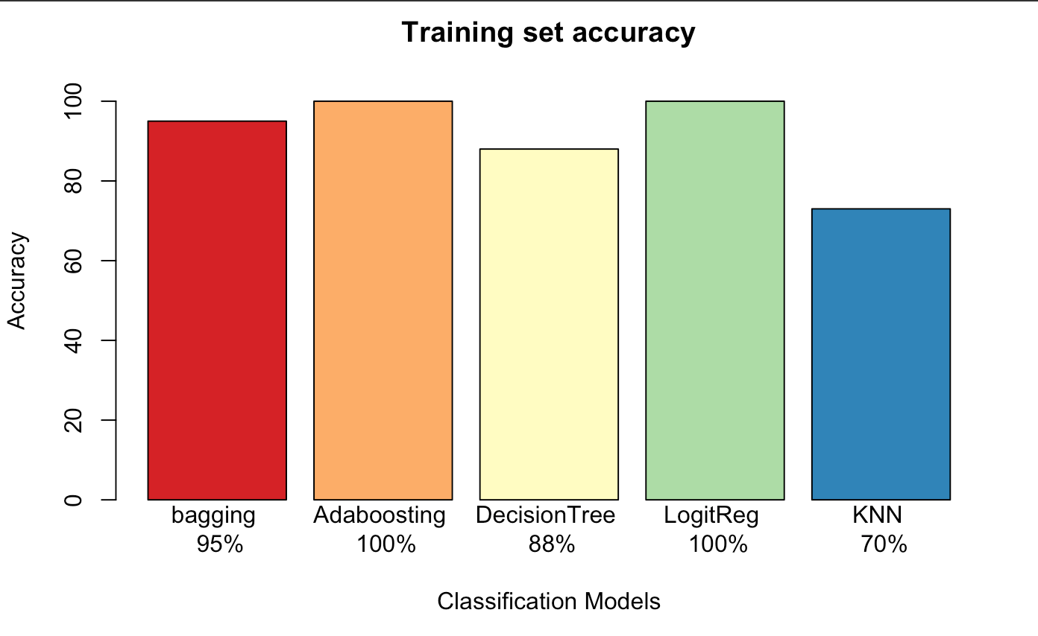
MODEL ACCURACY
Random forest
95%
Notes:
First let us take a look at the training accuracy for all 5 of our models. As you can see, all models except KNN scored an accuracy of above 88% with Logistic Regression and Adaboosting both had an accuracy score of 100%

Slide 6

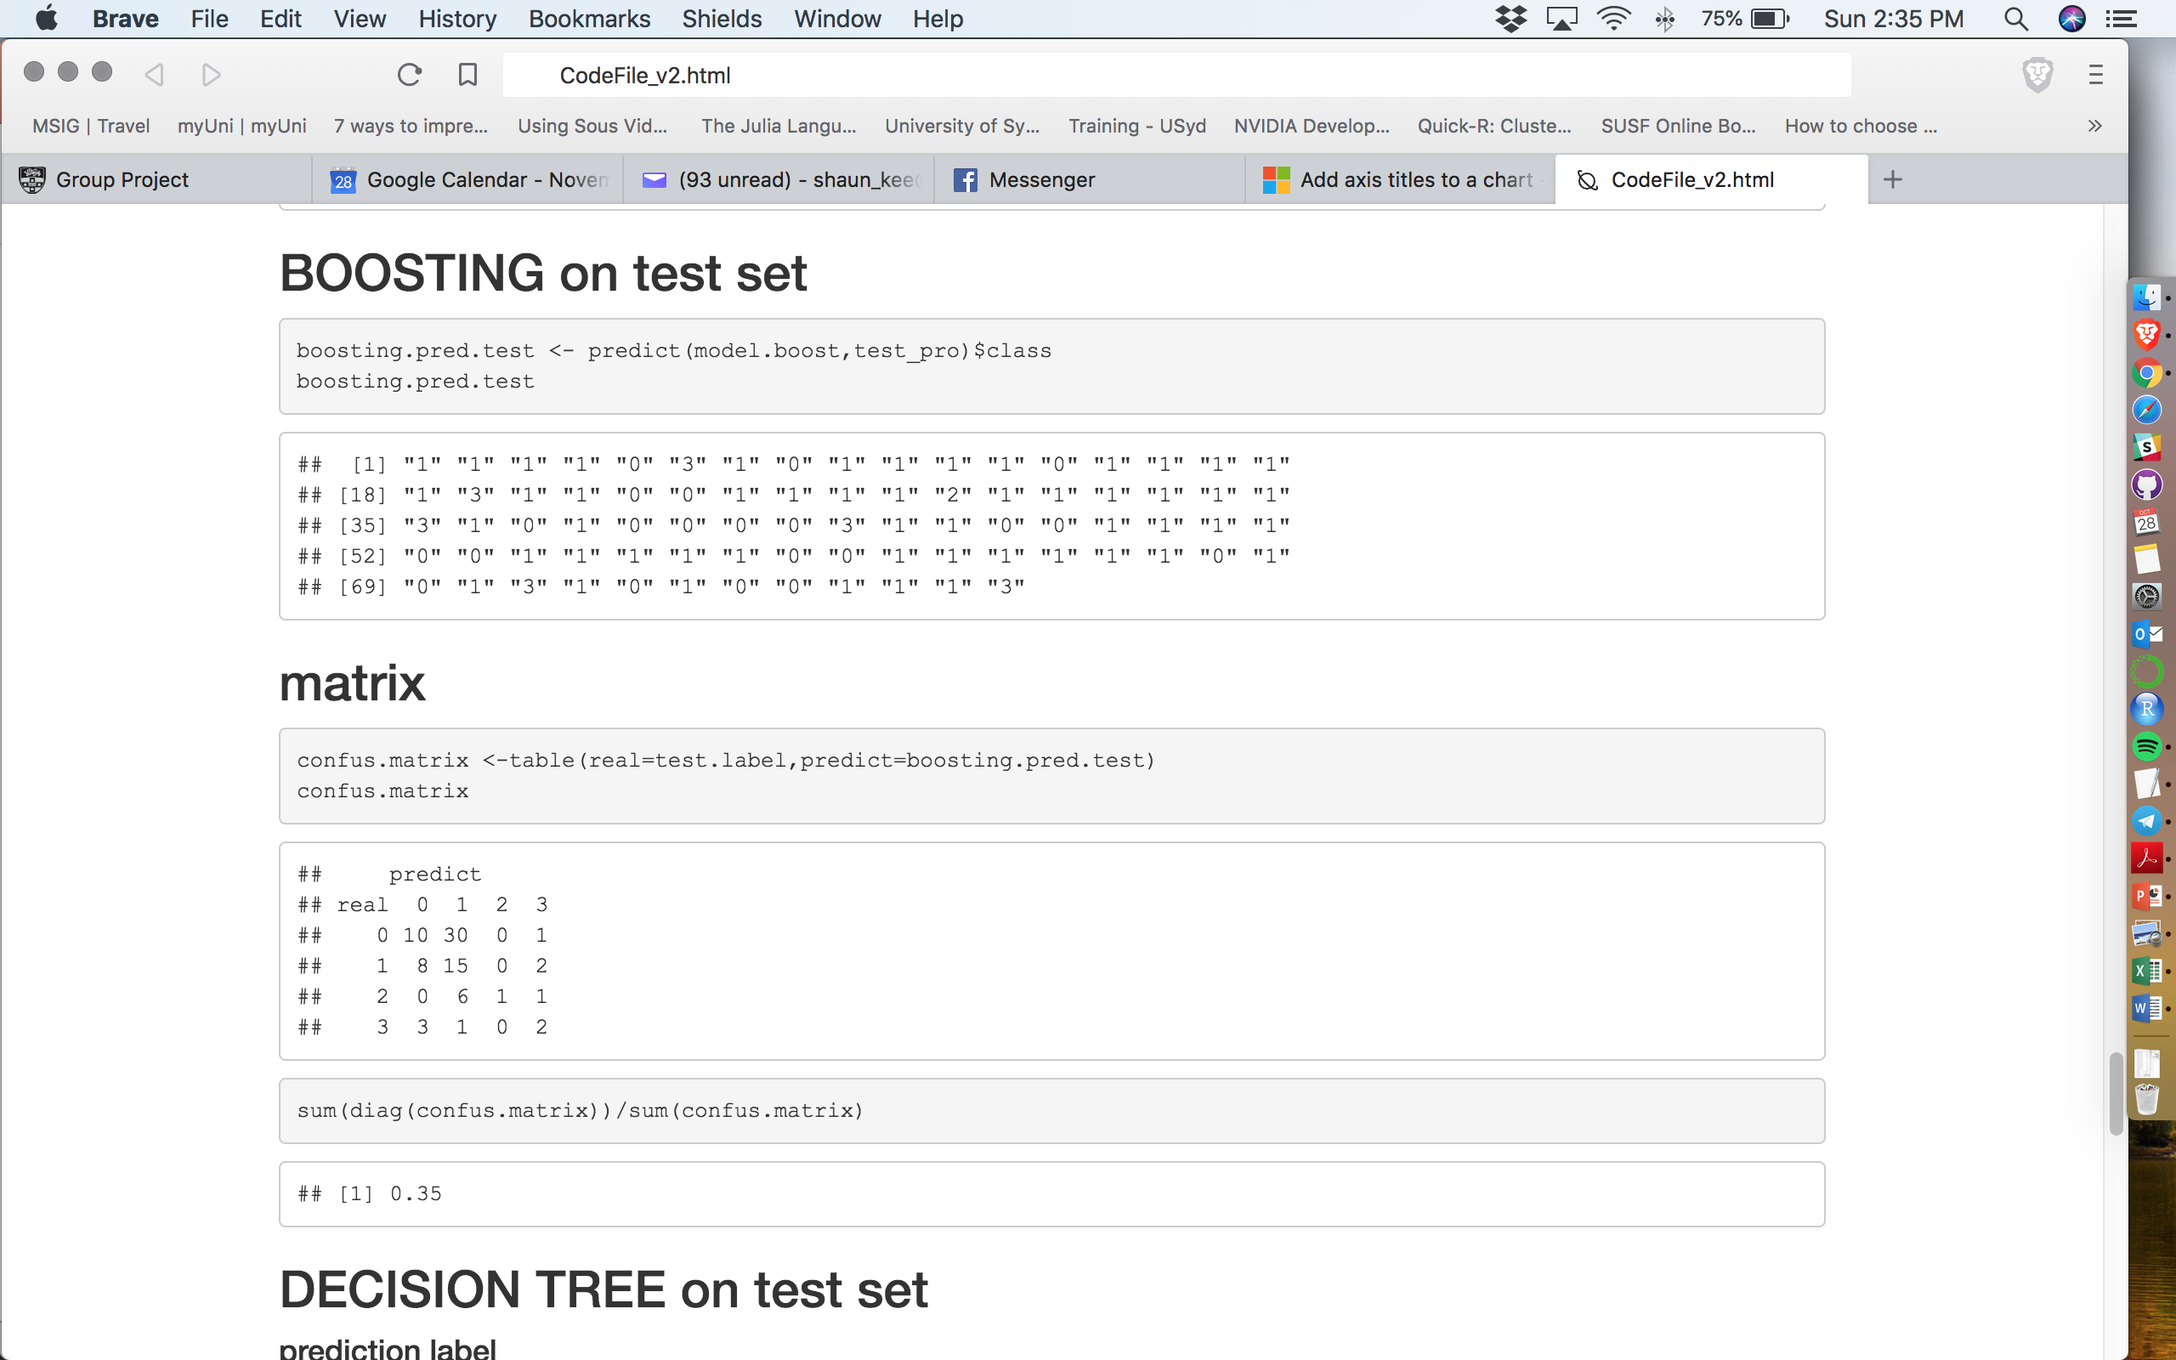
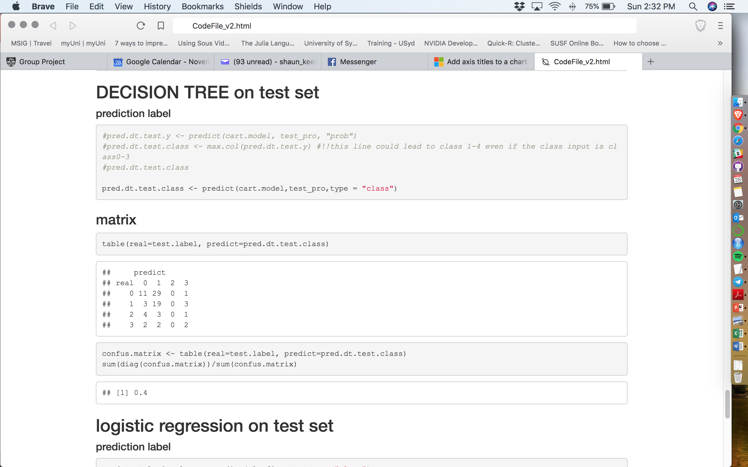
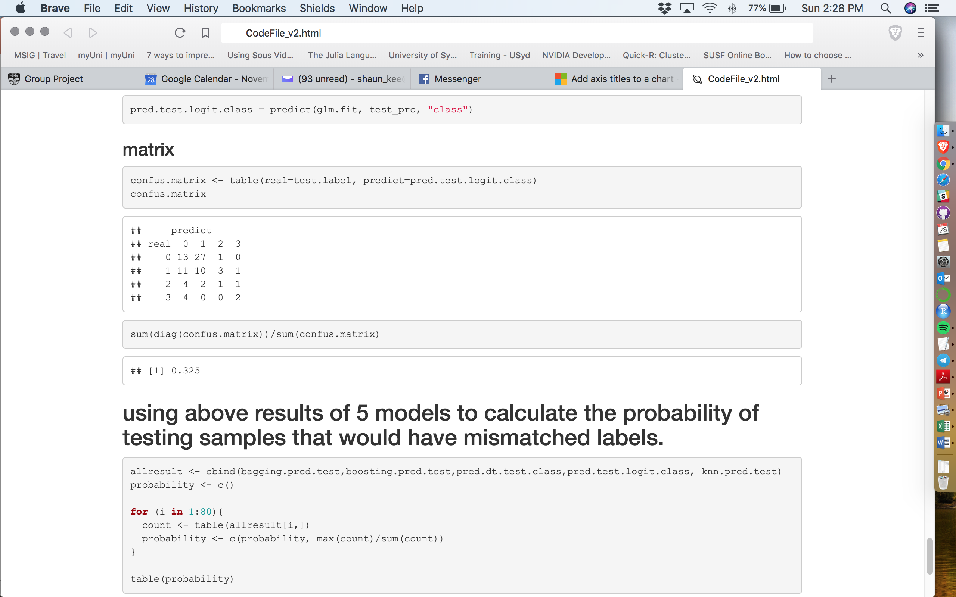
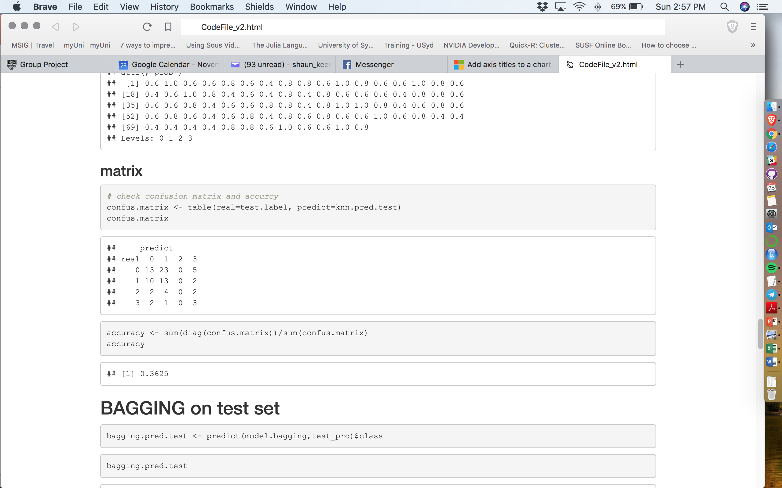
CONFUSION MATRIX
Random Forest Approach
Boosting Approach
Decision Tree Approach
Logistic Regression Approach
KNN Approach
Methods of defining mislabels
 | Model 1 | Model 2 | Model 3 | Model 4 | Model 5 | Probability of correct label
Sample 1 | class 1 | class 1 | class 1 | class 1 | class 1 | 1
Sample 2 | class 1 | class 1 | class 1 | class 1 | class 2 | 0.8
Sample 3 | class 1 | class 1 | class 1 | class 2 | class 2 | 0.6
Sample 4 | class 1 | class 1 | class 0 | class 2 | class 3 | 0.4 (this sample might be mislabeled)
…
Notes:
Using our trained models, we applied the models on our test dataset. Our benchmark would by if the class of an entry is pick at random, it would yield a 25% chance of getting a class correct. All 5 models scored an accuracy score between 31% to 40% with the Decision Tree approach having the highest score of 40% and Bagging approach having the lowest score of 31.25%.
A closer look at the confusion matrixes shows that the models are able to predict class 1 fairly accurately at about 60% accuracy. Most models predicted majority of class 0 as class 1 and were not able to predict the remaining classes accurately. So for future improvement of the models, oversampling techniques on the minority class can be applied as the dataset also suffers from class imbalance. This could improve the overall classification accuracy for class 2 and class 3.
However, baring in mind that our approach to identifying erroneous entries is by using the voted label derived from the summation of the 5 models label classification results, this puts lesser emphasis on the performance of each individual models. As you can see in the table below, for each samples, we compute the total number of times each class is predicted and calculate the biggest class probability. Samples with 0.4 probability or lower could mean that the sample might be mislabeled.

Slide 7
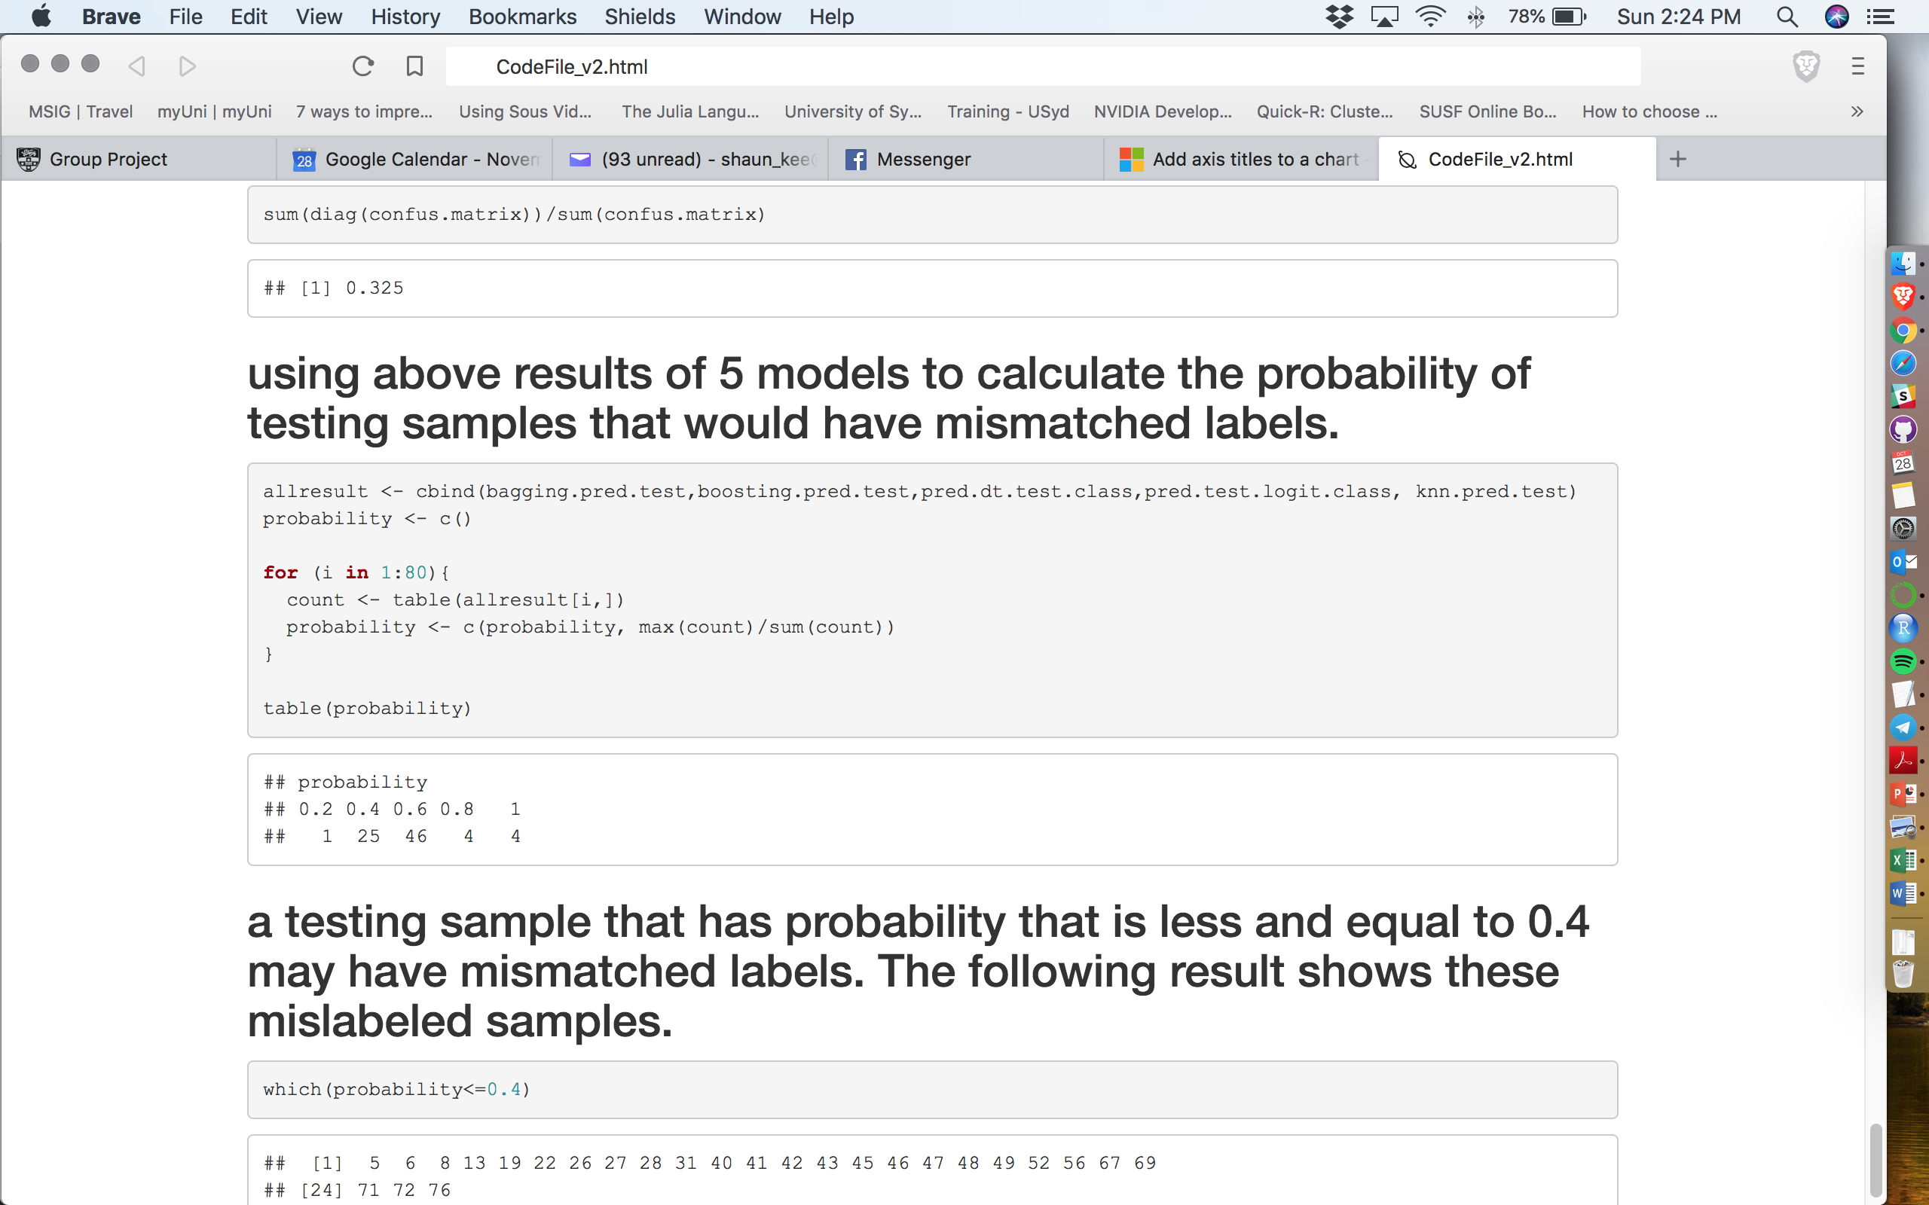
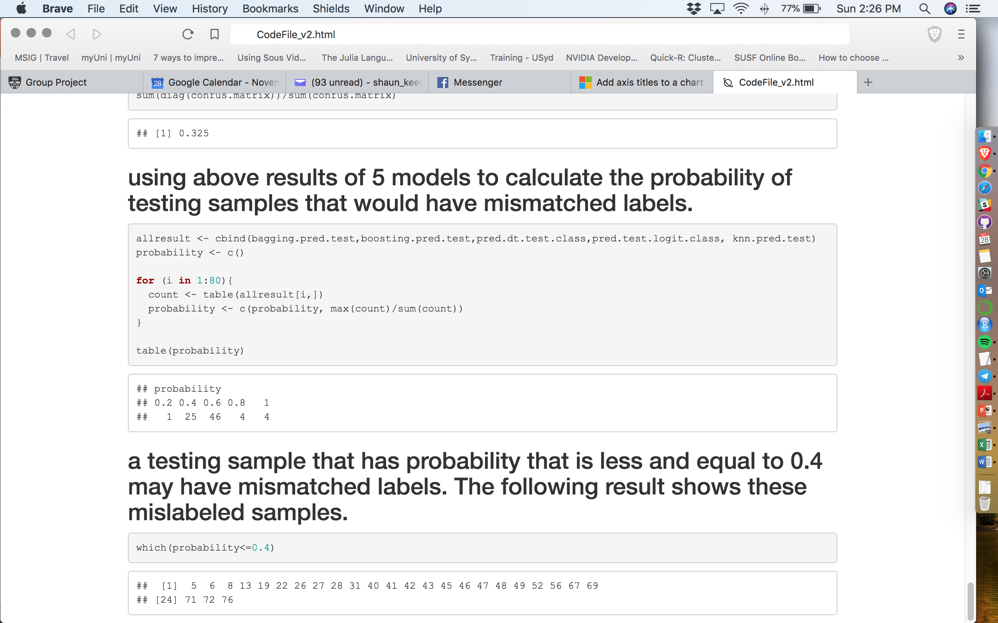
PREDICTED CLASSES PROBABILITY CHART
Possible mislabeled entries
Notes:
We tabulated the predicted labels of the test dataset from the 5 models and plot the probabilities of the entries having the same predicted class. From the chart, you can see that 54 entries scored higher than 60% probability of having the same predicted class while 25 entries scored less than 40% of having the same predicted class. From this distribution we can deduce that we potentially have 26 entries that might possible be mislabeled. The table on the bottom shows the possible mislabeled entry.

